Slide 1
Applying for
GISCI Certification
A Guide to Completing an Online Application for the GISP Portfolio Review
Experience

Slide 2
The Certification Process
Requires submission of a professional portfolio and successful passing of the GISCI Geospatial Core Technical Knowledge Exam^{R}
The portfolio requires completion of all three components (education, experience, & contributions to the profession).

Slide 3

Your GISCI Portfolio: Experience

Slide 4

Helpful Tip
Before you Begin
There is no benefit to documenting a high point total. The point total is used only during application assessment and is not noted or reflected in your final certificate. It is unnecessary to expend extensive effort documenting minor achievements unless the point values are needed to meet the minimum.

Slide 5
The Professional Experience Component
The Applicant will need a minimum of 60.0 Professional Experience Points to satisfy this section.

Slide 6
Removal of Personal Information
All sensitive or personal information (i.e., social security number, drivers license number, maiden name, etc.) may be removed or obscured from any document.
If this information is included only the GISCI staff and Review Committee Members will view it.

Slide 7
The Professional Experience Component
NOTE: If you have less than 4 years (48 months) of professional experience, you may not apply for GISCI Certification regardless of your point totals in this or any other category.
This four-year minimum requirement can come at any of the three levels of technical complexity.

Slide 8
Professional Experience Supervisory Bonus
Bonus points for years in a GIS supervisory or management position
(points are additive to the other three positions, i.e., a GIS Manager who also manages the department would receive 25 points + 10 points per year in that position).

Slide 9
Notes on the Supervisory Bonus
Designed for management level GIS professionals who work less and less with the technology.
Personnel and department management, not project management.
Must also claim experience with concepts and software of GIS.
Cannot claim only the supervisory bonus.

Slide 10
Necessary Professional Experience Documentation
A signed letter from the applicant’s immediate supervisor or employer stating that the information listed in the portfolio is correct.

Slide 11
Notes on Completing the Professional Experience Section
All information is entered into the online portal.
This is a two-step process in order to achieve points. You will:
  ADD EMPLOYER - with description and time interval for postions held, then,
  ADD EXPERIENCE - describe the Tier Level/s into which your job/s fell.

Slide 12
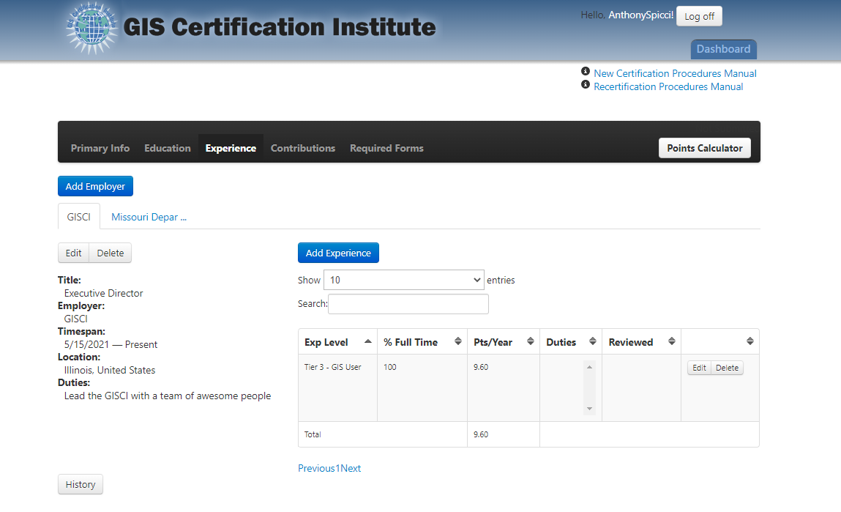
The Professional Experience Worksheet

Slide 13
Completing the Professional Experience Worksheet: New Employer
Start with ‘Add Employer. This will start a new instance of an employer.

Slide 14
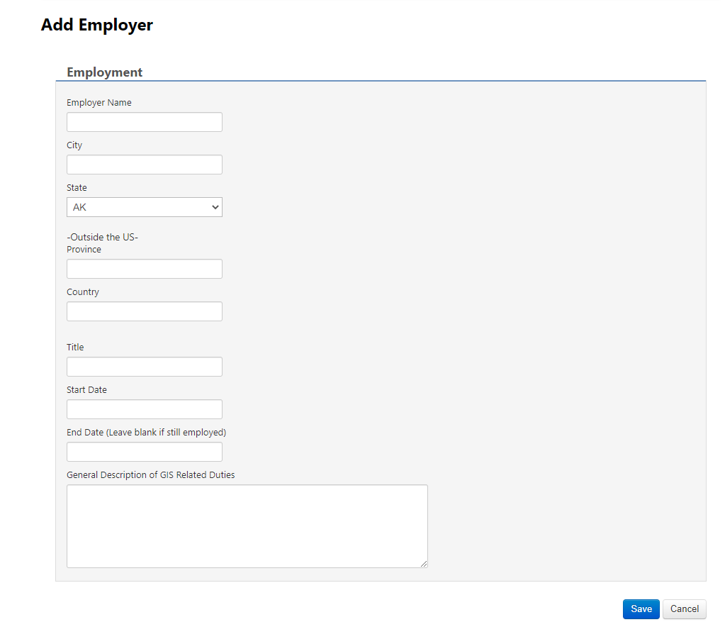
Completing the Professional Experience Worksheet: New Employer
Enter name of employer
Enter appropriate information
Enter job title & dates
Enter a general description; details come later

Slide 15
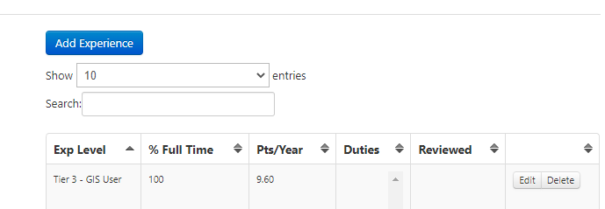
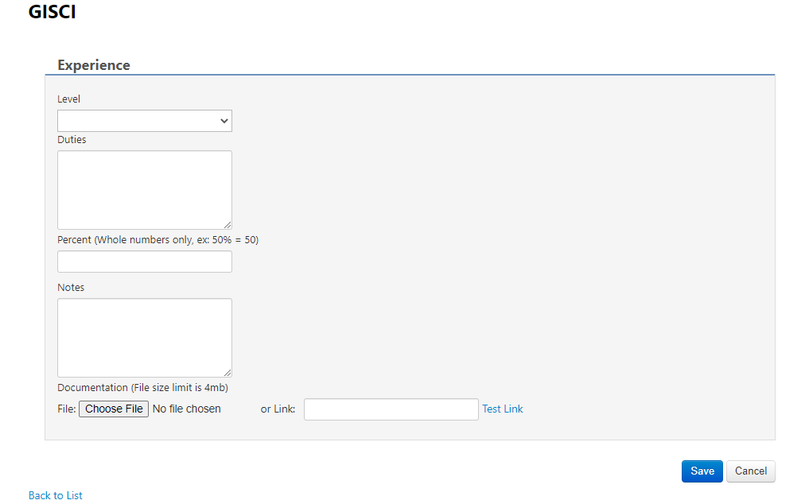
Completing the Professional Experience Worksheet: Adding Experience
Click to Add Experience. A new window will pop up
Choose level (next slide)
Add duties
Add % of your job performing each level.

Slide 16
3 Levels of Technical Complexity
Tier I: Analyst, System Design, Programming:
Typical tasks include database design or management, documentation or analysis of functional requirements, application design and evaluation, implementation management, and system administration. = 25 Points Per Year
Tier II: Data Compilation, Data Maintenance, Teaching:
Typical tasks include editing data, map composition, report generation, database maintenance, data validation, instructional training, and teaching. = 15 Points Per Year
Tier III: GIS User:
Typical tasks include utilization of applications involving geospatial technologies. Candidates may be involved in managing or coordinating GIS, but not involved in the technical implementation of GIS. = 10 Points Per Year

Slide 17
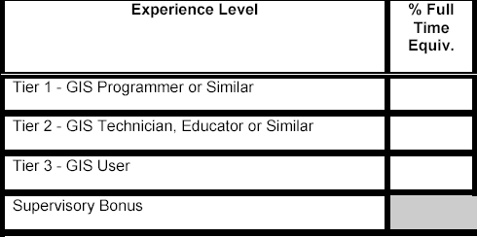
Full Time Equivalent Percentages (% FTE)
FTE% stands for Full Time Equivalent. "%FTE" is the decimal portion of time credited towards a particular experience level and supported by the description of GIS related duties section.

Slide 18
Full Time Equivalent Percentages (% FTE)
FTE% Example:in a GIS shop, an applicant might spend 70% of their time doing application development and system maintenance and 30% of their time doing data maintenance and update. It would be appropriate for the applicant to record .7 for "GIS Programmer or Similar" and .3 for "GIS Technician or Similar". Also, bonus points are awarded if they have supervisory responsibilities
Experience Level | % Full Time Equiv.
Tier 1 - GIS Programmer or Similar | .70
Tier 2 - GIS Technician, Educator or Similar | .30
Tier 3 - GIS User
Supervisory Bonus (“%FTE” cannot exceed 1.00) | .50

Slide 19
Full Time Equivalent Percentages (% FTE)
In most cases, values entered in "%FTE" will sum to 1. In cases where sales, an academic internship or part-time research is involved, the values in "%FTE" should sum to the appropriate proportion (e.g.: .4 for a half-time graduate research assistant, as appropriate).
Experience Level | % Full Time Equiv.
Tier 1 - GIS Programmer or Similar
Tier 2 - GIS Technician, Educator or Similar | .20
Tier 3 - GIS User | .20
Supervisory Bonus (“%FTE” cannot exceed 1.00)

Slide 20
Completing the Experience Professional Profiles
Each employer will have its own entry.
Only claim job experience related to geospatial activities.
When describing Duties, be brief but thorough. We have extensive experience understanding job descriptions from across all industries!

Slide 21
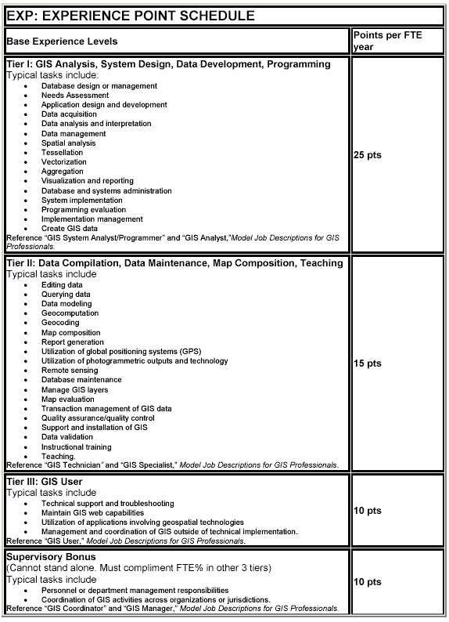
The EXP: Experience Points Schedule

Slide 22
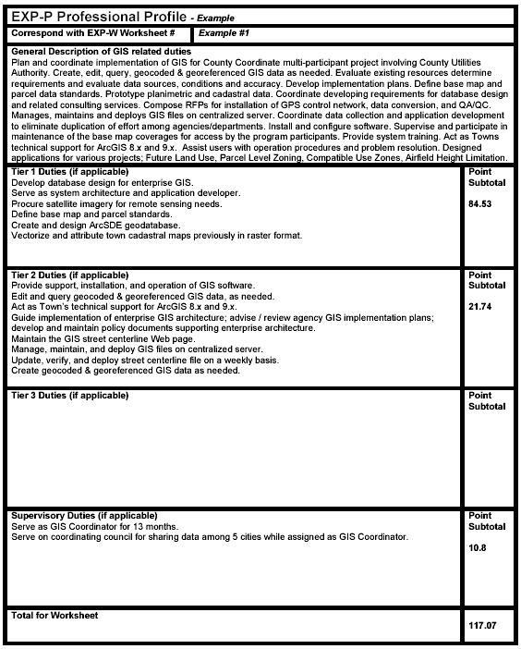
Example of an Experience Profile

Slide 23
Completing the Supervisory Bonus
In order to get full credit for Supervisory Bonus points, you will need to create a 2nd instance of the employer and time period of employment, then list the Supervisory Tier by itself.
Supervising can be in addition to, or independent of, other geospatial work. You can be a GIS Supervisory with other non-GIS tasks to gain these points.

Slide 24
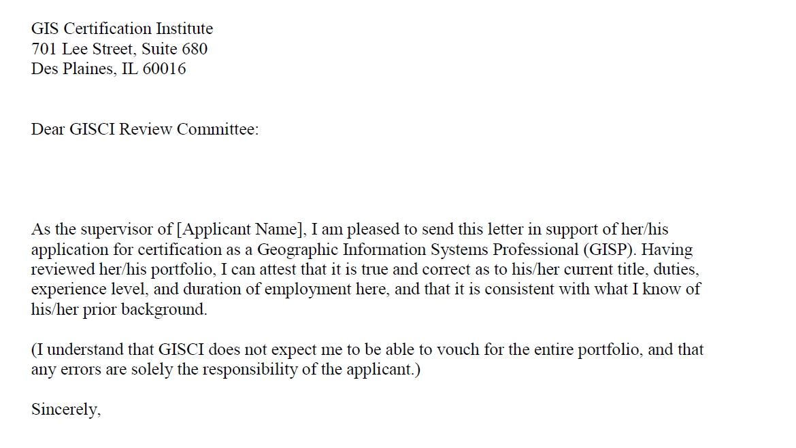
Letter from Immediate Supervisor
The supervisor letter can follow the GISCI template or contain different text. It must state that to the best of the employer’s knowledge the claims made within the professional experience component are correct.
The letter must be on company letterhead and be signed in ink. If the applicant does not have an immediate supervisor they should obtain a letter from a client, business partner, or past supervisor.

Slide 25
You have now completed the Experience portion of your Portfolio
But you aren’t done yet! Continue with the other sections.

Slide 26
Any Questions?
Contact GISCI
www.gisci.org
Email: info@gisci.org
Phone 847-824-7768
Fax 847-824-6363

