Slide 1
Applying for
GISCI Certification
A Guide to Completing an Online Application for the GISP Portfolio Review
Overview

Slide 2
Steps to Complete Your Portfolio
Remember that a GISP requires:
  4 years full-time geospatial experience
  Portfolio Review Approval (an online process)
  Taking and passing the GISCI Geospatial Technical Core Knowledge Exam (a separate signup; offered twice a year)
  A signed Ethics Statement
You can start the GISP process at any time in your career, but all must be met before the GISP will be awarded!

Slide 3
Portfolio Review: Getting Started
Register at www.gisci.org
Log back in with your credentials to access the form
  You will need a transcript of courses
  A signed Ethics Statement
  A letter from your current supervisor
  All will be uploaded to the application

Slide 4
Steps to Complete Your Portfolio
For the Portfolio Review Portion…………
Register and Log in online – access the online form to reach:
The Education Section
  Degrees/Certificates
  Coursework – Accredited Institution
  Coursework- Non-Accredited Institution
  Conferences & Webinars
The Experience Section
The Contributions Section

Slide 5
Helpful Tips Before you Begin
The Portfolio application is completed entirely online.
There is no benefit to documenting a high point total. The point total is used only during application assessment and is not noted or reflected in your final certificate.
It is unnecessary to expend extensive effort documenting minor achievements unless the point values are needed to meet the minimum.
A GISP approved with 150 points will be equivalent to one approved with a higher point total!

Slide 6
Removal of Personal Information
All sensitive or personal information (i.e., social security number, drivers license number, maiden name, etc.) should be removed or obscured from any document.
If this information is included only the GISCI staff and Review Committee Members will view it.

Slide 7
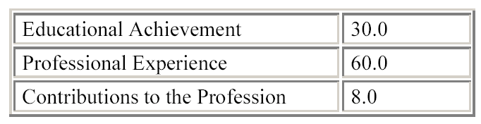
Certification Point Requirements
A total of 150 points is required to become certified.
The applicant will need the following minimums in the three achievement categories:
Supplemental Points: The candidates will also need an additional 52 points in any of the three categories. The web site will automatically assign surplus points in each category to the Supplemental category.
The Submit button will not appear until all
category minimums are met.

Slide 8
Portfolio Review: Payment
Once you submit your Portfolio Review application, you will be prompted to pay online.
You may also request an invoice. If so, you will be contacted by our Certification Coordinator for full payment.
GISCI accepts checks and credit cards.
We can provide invoices and receipts, as needed for organizational reimbursement.
Completion of the Portfolio Review will still require the taking of the GISCI Exam.
When you start the GISP process with either the Portfolio Review
or the Exam, you have up to 6 years to complete the
process.
Notes:

Slide 9
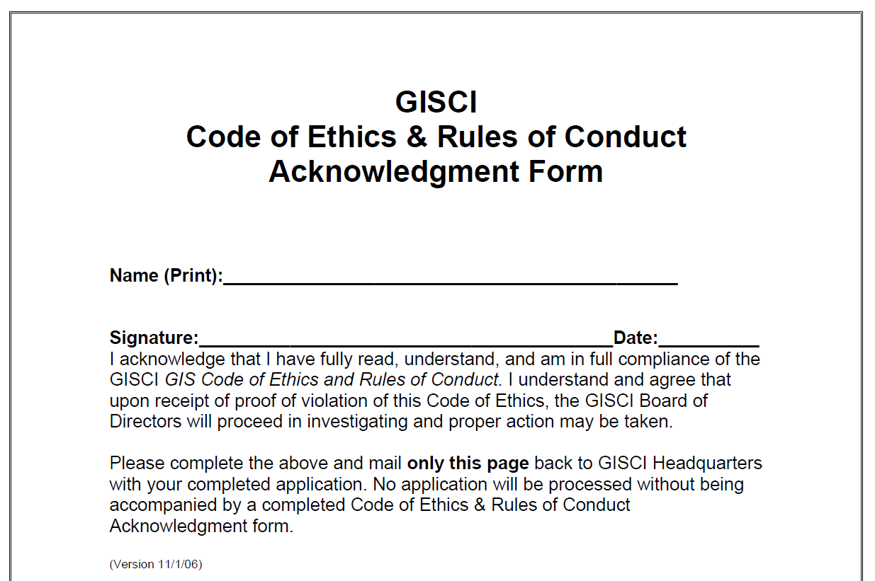
The Code of Ethics Acknowledgment Form
A blank copy of the GISCI Code of Ethics is available online for download under ‘Required Documents’
The form must be signed and dated and uploaded to the Required Documents portion of the application.
No candidate, regardless of points will be considered certified without signing the GISCI Code of Ethics.

Slide 10

You have now completed the body of the Application.
But you aren’t done yet!

Slide 11
Additional Resources
See The Education Section PowerPoint
See The Experience Section PowerPoint
See The Contributions Section PowerPoint

Slide 12
You Have Just Completed the Portfolio Review Overview
Thank you very much for your interest and support.

Slide 13
Any Questions?
Contact GISCI
www.gisci.org
Email: info@gisci.org
Phone 847-824-7768
Fax 847-824-6363

